Slide 1

"Advancing Biodiversity Conservation: Comparative Evaluation of Machine Learning Models for Species Classification"
Ryan Junejo
Vector Research Intern Supervised by Graham Taylor

Slide 2
Overview
1)
Biodiversity Classification and Nate’s RAG Project
A brief summary of Biodiversity Classification, Nate’s RAG Project, and the TOL10M+ and iNaturalist datasets
2)
Models and the Training Process
An Overview of Hiera and CLIP. How did I set up the training process? What did that look like?
3)
Results + Lessons Learned
What was the outcome of the evaluations? What lessons did I learn from these datesets and models?
Future RAG methologies, INAT discovery and discussions, Impact
4)
A brief talk about techniques I discovered this past month as well as some fascinating research in biodiversity classification

Slide 3
Machine Learning for Species Classification

Slide 4
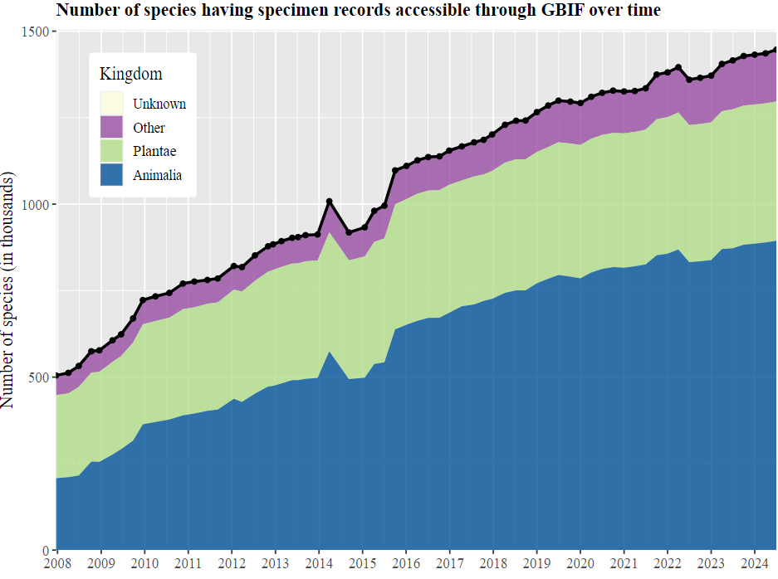
Up to one million species are threatened with extinction, many within decades. [1]
Monitoring Biodiversity has proven to be a challenge for many decades however machine learning has grown to be a big part of the developing solution thanks to increasingly available biodiversity data.
[1] https://www.un.org/en/climatechange/science/climate-issues/biodiversity
[2] https://www.gbif.org/analytics/global

Slide 5
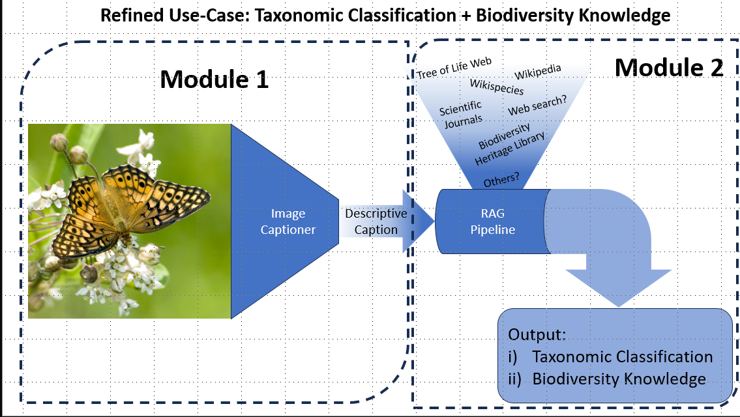
Nate Lesperance’s RAG Project

Slide 6
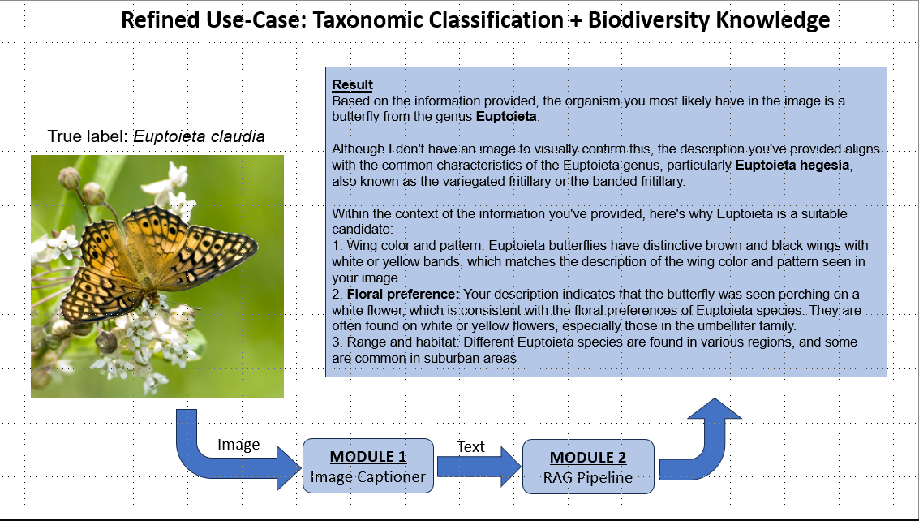

Slide 7
Datasets
INATURALIST 2019
INATURALIST 2021
1010 Species
268,000 images
Crowd-Sourced Images
10,000 Species
2.7M images
‘Mini’ has 500K images
Crowd-Sourced Images
TREE OF LIFE 10M+
RARE SPECIES
45,000 Species
10M+ images
Comprised of iNaturalist, BioScan-1M, Encyclopedia of Life (EoL)
400 Species
12,000 images
Data from Encyclopedia of Life

Slide 8
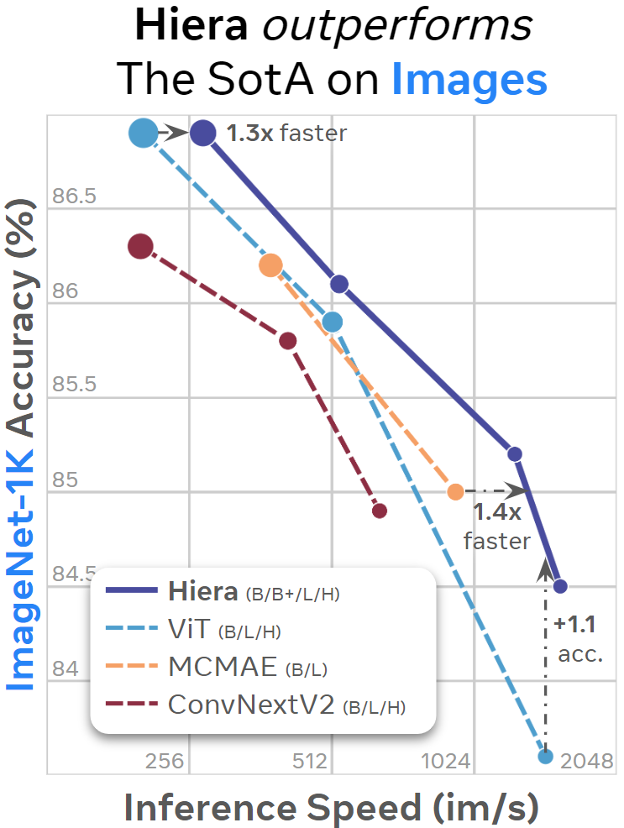
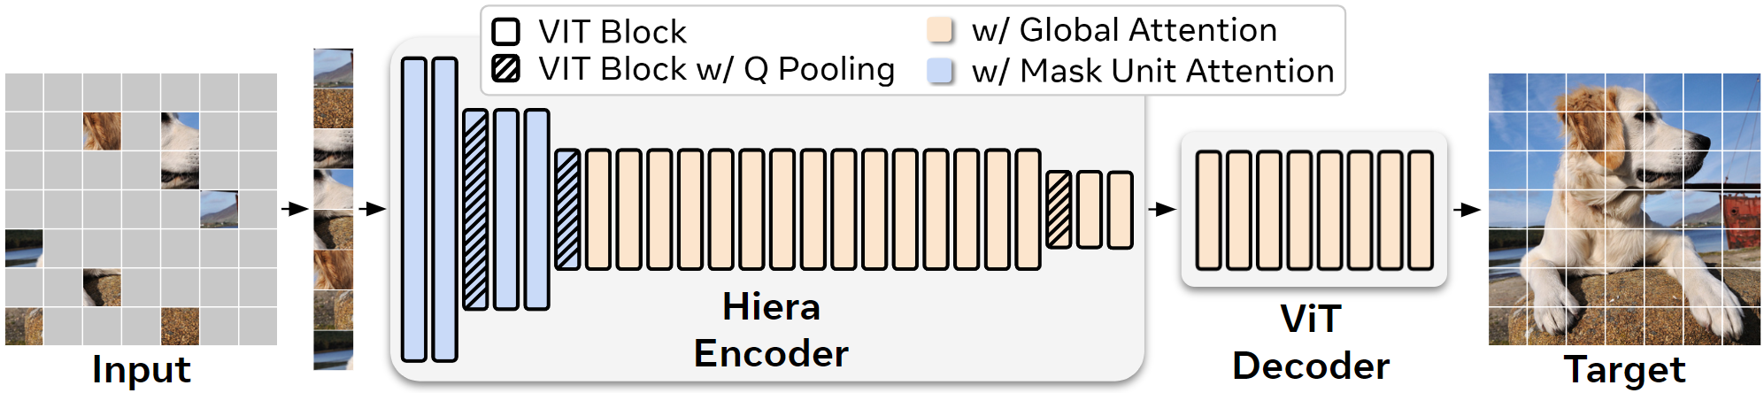
Model 1: Hiera
“A Hierarchical Vision Transformer without the Bells-and-Whistles”
Hiera is a hierarchical vision transformer that is fast, powerful, and, above all, simple. It outperforms the state-of-the-art across a wide array of image and video tasks while being much faster.
Hierarchial Vision Transformers progressively reduce the spatial resolution of the input image while increasing the number of feature channels as the network goes deeper.
Hiera uses Masked Autoencoder (MAE) Training to naturally learn spatial biases by reconstructing masked portions of the input image.

Slide 9
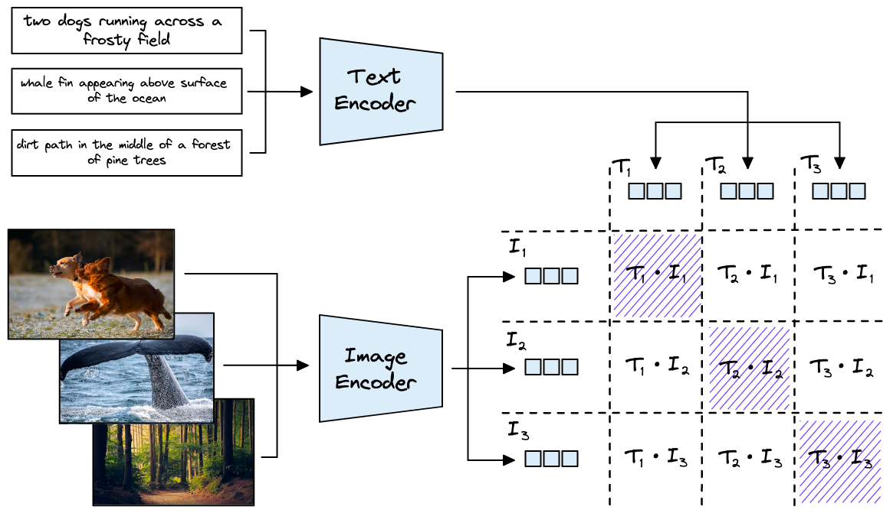
Model 2: CLIP
CLIP (Contrastive Language-Image Pre-Training) is a neural network trained on a variety of (image, text) pairs.
It uses Vision Transformers and Text Transformers to create separate embeddings.
Both the image and text embeddings are projected into a shared embedding space where similar images and texts are close together. This shared space enables the model to compare images and text directly..
Very effective for Zero-Shot Learning

Slide 10
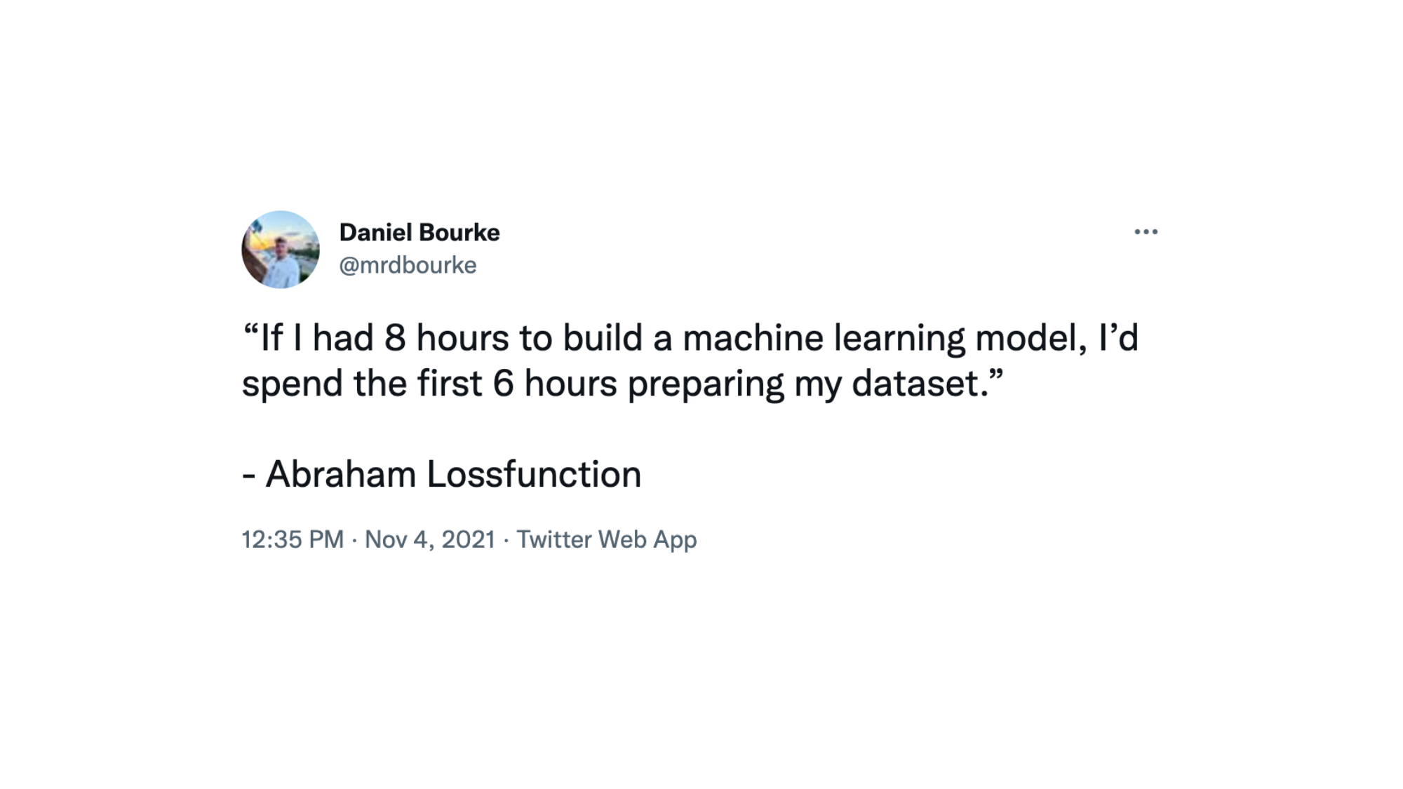
The Training Process

Slide 11
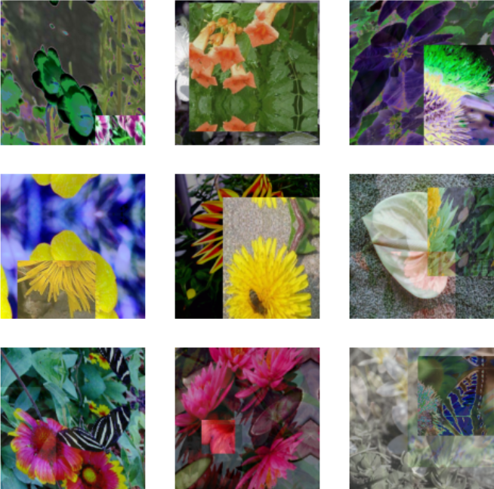
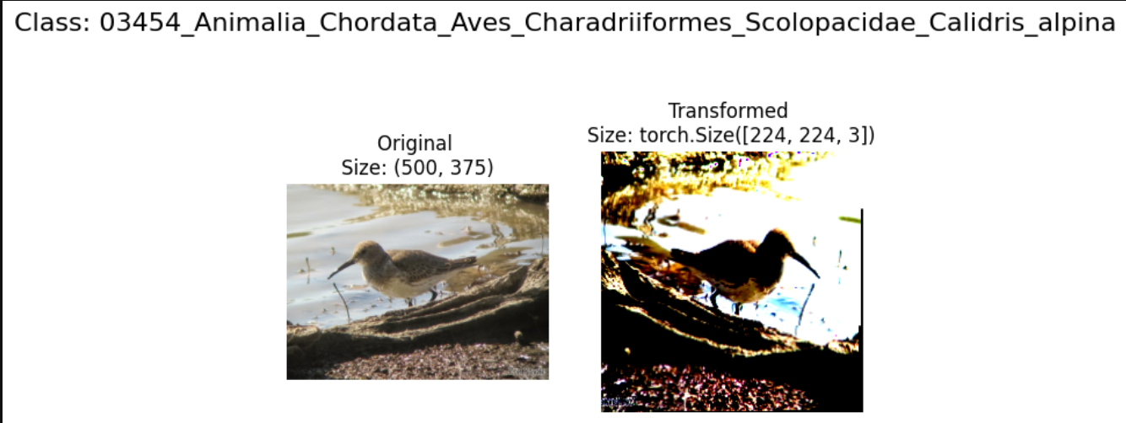
Data Augmentations
After Random Augment
After RandAugment, Cutmix and Mixup

Slide 12
Additional Parameters
Label Smoothing: Prevents model becoming overconfident in it’s predictions
Cosine Decay LR Scheduler: This allows the model to take larger steps initially and smaller steps as it converges, leading to better fine-tuning.
Drop Path and Layer Wise Decay: Drop Path helps avoid overfitting by randomly dropping parts of the model during training. Layer-wise decay ensures that lower layers, which capture more general features, are not overly modified, while upper layers, which learn species-specific features, receive more updates.

Slide 13
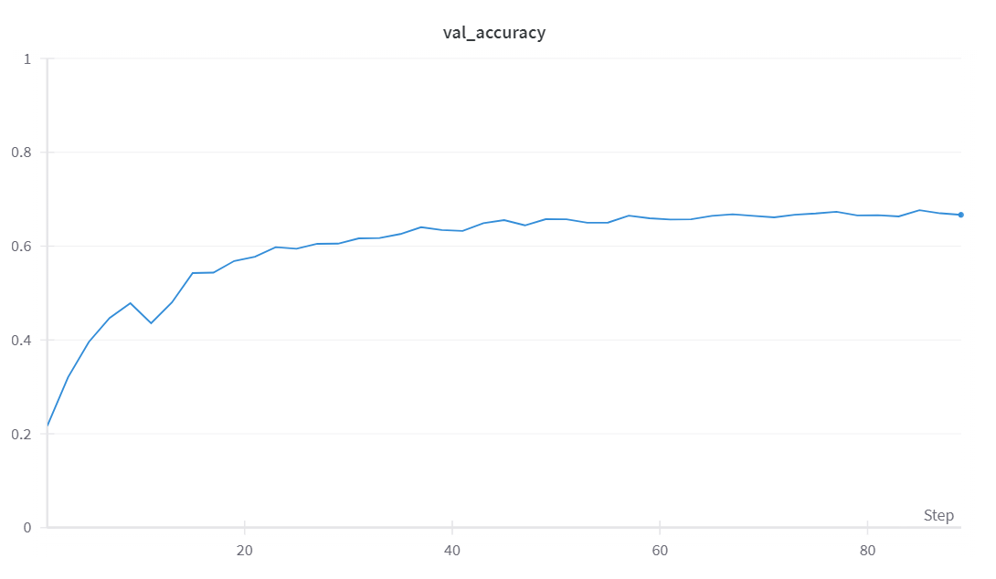
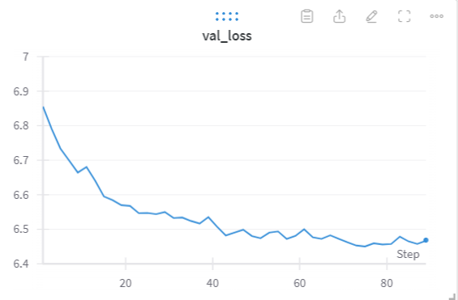
Results with Hiera(T) on iNaturalist 2019
Accuracy peaks at 0.7

Slide 14
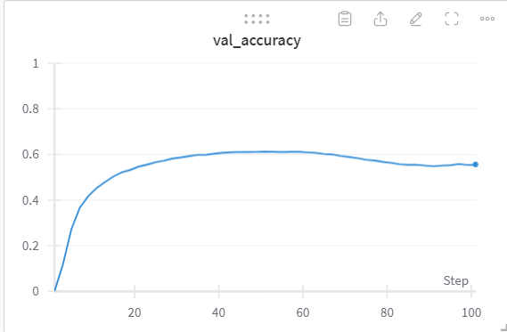
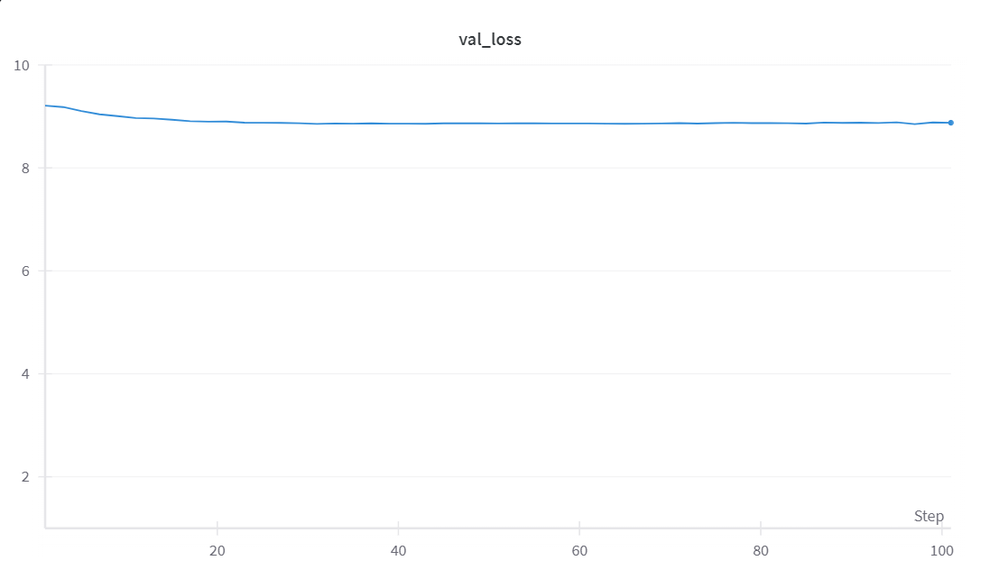
Results with Hiera(T) on iNaturalist 2021 (Mini)
Accuracy peaked at 0.61
(same as WaveMix-256/16)

Slide 15
CLIP Evaluations

Slide 16
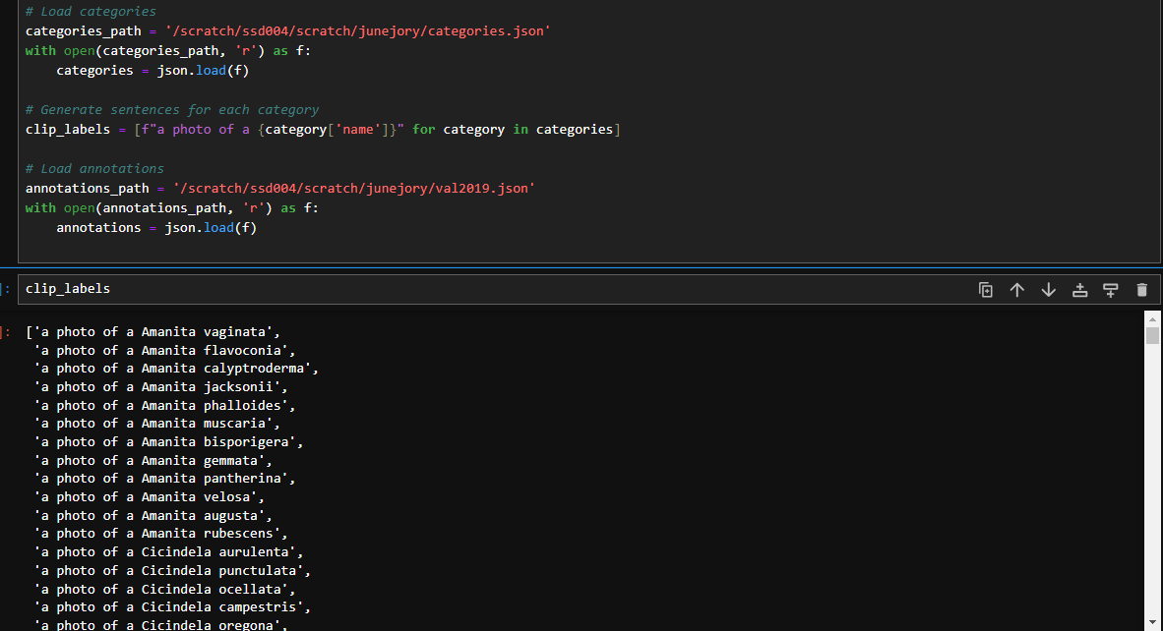
Creating Clip Labels and Embeddings

Slide 17
Battle of the CLIPS

Slide 18
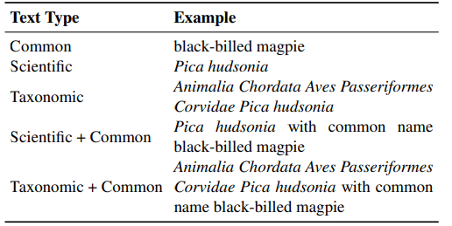
Text Types for BioCLIP
Now that we’ve determined BioClip’s efficiency, we wanted to see what types of text types for the CLIP Labels worked best for species classification.
We used the Rare Species Dataset as an evaluation metric as BioCLIP considers these as previously unseen species in it’s training data.
Additionally, we wanted to see what the difference was in using a label such as “a photo of” as a prefix to text types.

Slide 19
Battle of the Text Types

Slide 20
Additional Comparisons BioCLIP(10M+) vs BioCLIP(iNat-21) on iNat-21

Slide 21
Challenges Faced
Memory Considerations
Storage Problems
iNaturalist is highly imbalanced causing data offsets
Hard to trace back problems when Epochs would take 30 minutes each

Slide 22
Lessons Learned
Iterate Iterate Iterate!
Get to know your Dataset, especially large ones like iNaturalist
Large Datasets take TIME. Don’t be afraid to use more power (and batch size)

Slide 23
Future RAG methologies and other Biodiversity Projects

Slide 24
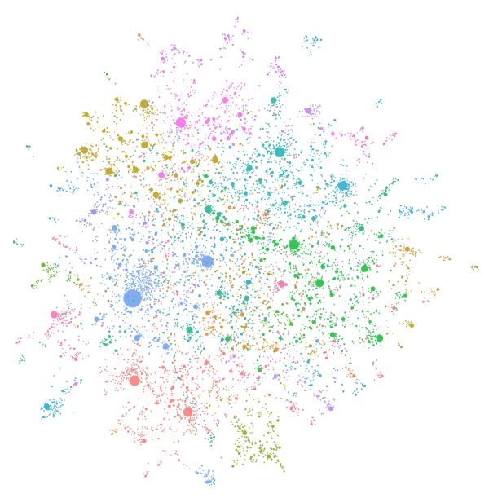
Graph RAG
Combines the strengths of graph neural networks (GNNs) and retrieval-augmented generation (RAG).
Leverages structured knowledge graphs to enhance classification and inference tasks.
Incorporates retrieval mechanisms to dynamically fetch relevant data during model training and inference.
Species Identification: Improves species classification by integrating taxonomic hierarchies and ecological relationships.
This may also aid the model in identifying different transitions of a species like a tadpole turning into a frog

Slide 25
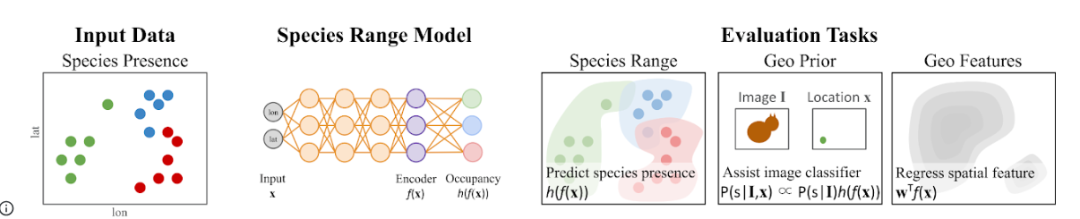
Interesting Read that also features iNaturalist
Spatial Implicit Neural Representations for Global-Scale Species Mapping by Elijah Cole
Spatial Implicit Neural Representations (SINRs) are used to predict species presence/absence across locations by leveraging large-scale, crowdsourced datasets, enabling the simultaneous estimation of geographical ranges for 47,000 species.
Scalability and Improved Predictions: The approach shows better performance as the number of species and data increases, efficiently handling noisy and biased data to approximate expert-developed range maps.

Slide 26
Credits: Thank you to Graham Taylor and the Vector Team for giving me this oppurtunity Thank you to Nate for meeting with me every week to discuss the project! Thank you to the MLRG team for having me!

